Slide 1

Reading Habit Differences Across Ages Matthew A. Sabony MGMT-581L

Slide 2





Agenda
Problem Identification
Data Preprocessing
Hypothesis Testing
Machine Learning Models
Interpreting Results
2

Slide 3
Dataset & Variables
Reading Habit Dataset, Pew Research Center
Age | Ratio | Age of respondent
Sex | Nominal | Sex of respondent (M/F)
Race | Nominal | Race of respondent
Marital_Status | Nominal | Marital status of respondent
Education | Interval | Highest education level achieved by respondent
Employment | Nominal | Employment status of respondent
Income | Interval | Income range of respondent
Num_of_Books | Ratio | Number of books respondent has read in the previous 12 months
Printed | Nominal | Has the respondent read any printed books in the previous 12 months (Y/N)
Audio | Nominal | Has the respondent read any audio books in the previous 12 months (Y/N)
EBooks | Nominal | Has the respondent read any eBooks in the previous 12 months (Y/N)
Acquisition_Method | Nominal | How does the respondent acquire their books
Daily_News/Newspaper | Nominal | Does the respondent read any daily news and/or newspapers (Y/N)
Maganizes_Jounrals | Nominal | Does the respondent read any magazines and/or journals (Y/N)
Problem Identification | Data Preprocessing | Hypothesis Testing | Machine Learning Models | Interpreting Results
3

Slide 4
Uses and Limitations
Is there a significant relationship between reading habits and age?
Do older people actually read more?
Potential Limitations:
Response Bias – Respondents may feel they should give more socially desirable answers.
Limited Timeframe – Results are only of reading habits from previous 12 months, not overtime. Circumstances may affect responses.
Binary Responses – Variables that are binary won’t account for preference or frequency.
Book Length – No variable to account for book length. Somebody who read 97 book in the past twelve months could have been reading 97 books under 50 pages and somebody who read 1 book in the past twelve months could have read one encyclopedia.
Problem Identification | Data Preprocessing | Hypothesis Testing | Machine Learning Models | Interpreting Results
Problem Identification | Data Preprocessing | Hypothesis Testing | Machine Learning Models | Interpreting Results
4

Slide 5
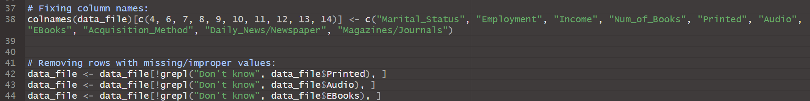
Data Cleaning
Some columns had incorrect or confusing names that I relabeled below:
Dataset required no cleaning beyond renaming variables during preprocessing.
No erroneous values in important variables (Age, Num_of_Books, Printed, Audio, EBooks).
Age and Num_of_Books had no missing or “Don’t know” values.
Printed, Audio, and EBooks only had missing values when respondents answered that they read 0 books.
Rows with “Don’t know” values were kept for potential significance between Age and Num_of_Books and removed later.
No respondent ID, duplicates are possible.
Outliers in Age and Num_of_Books are still important and removing would remove ability to learn about certain age groups reading habits.
Problem Identification | Data Preprocessing | Hypothesis Testing | Machine Learning Models | Interpreting Results
Problem Identification | Data Preprocessing | Hypothesis Testing | Machine Learning Models | Interpreting Results
5

Slide 6
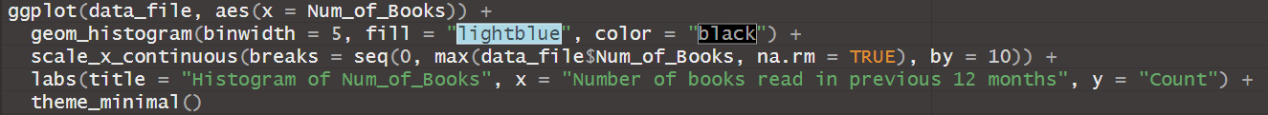
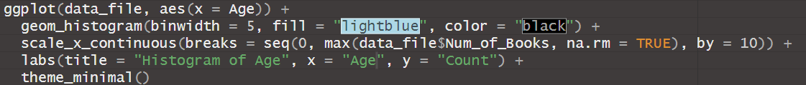
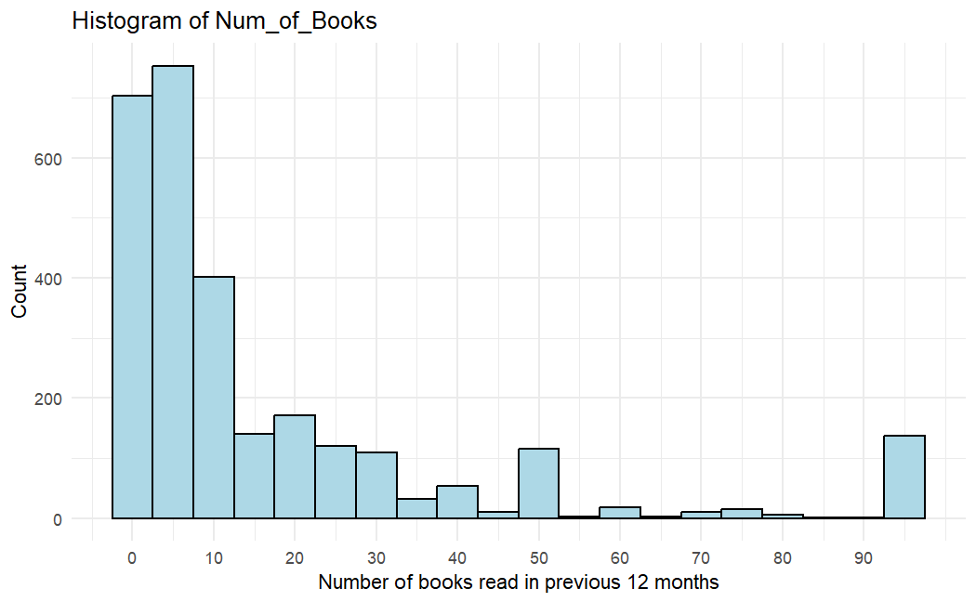
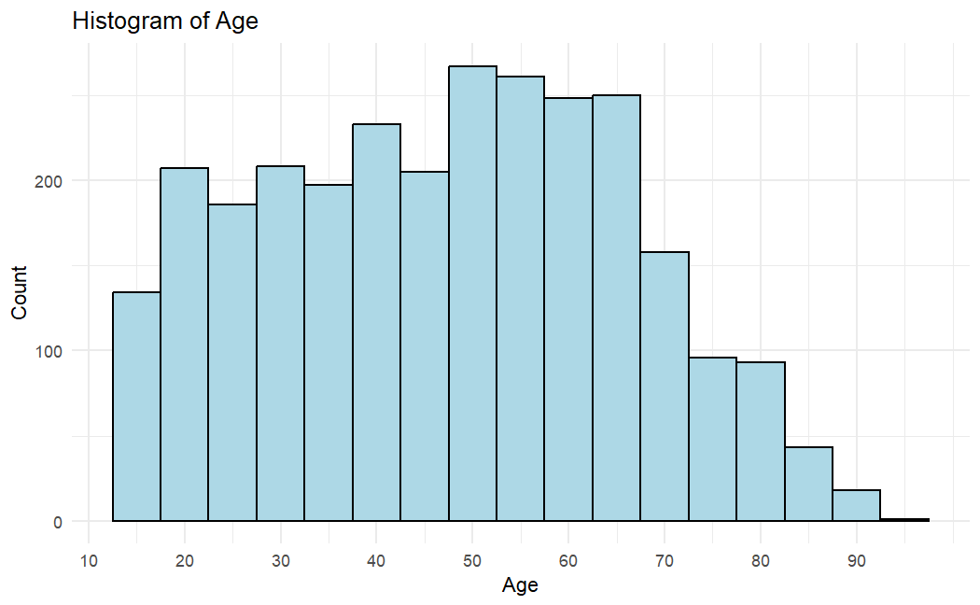
Histograms – Num_of_Books & Age
Problem Identification | Data Preprocessing | Hypothesis Testing | Machine Learning Models | Interpreting Results
6

Slide 7
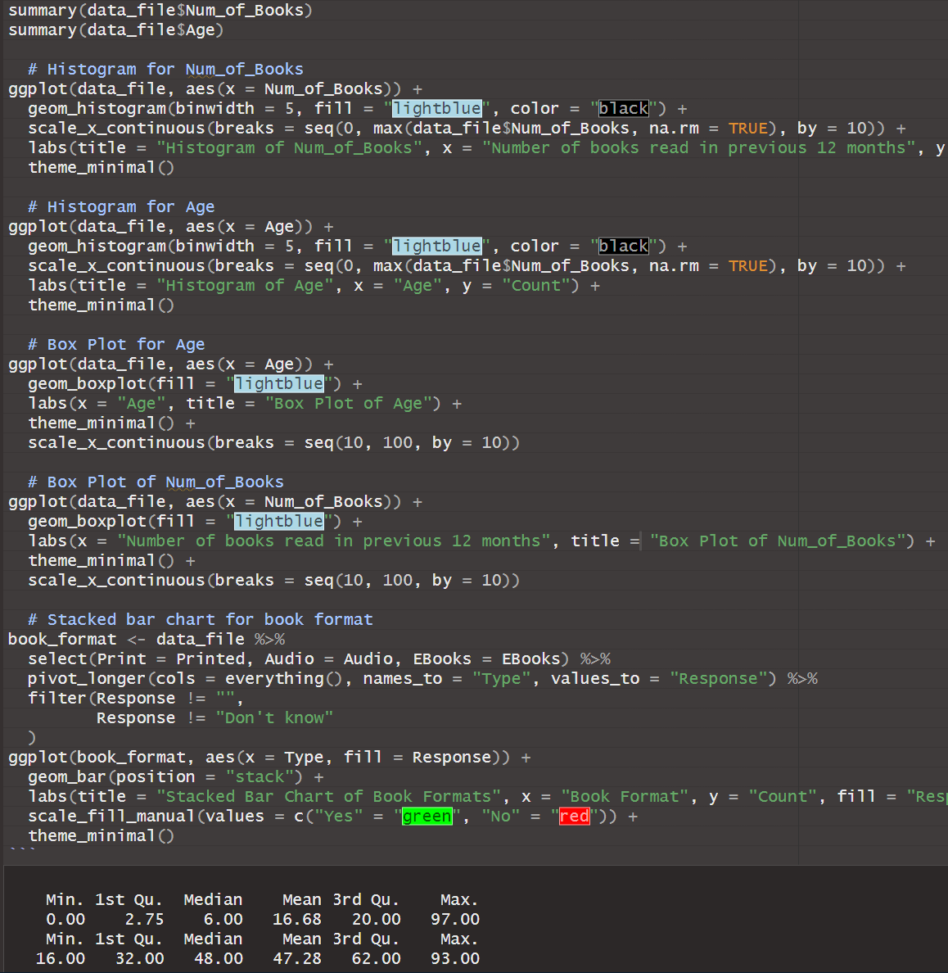
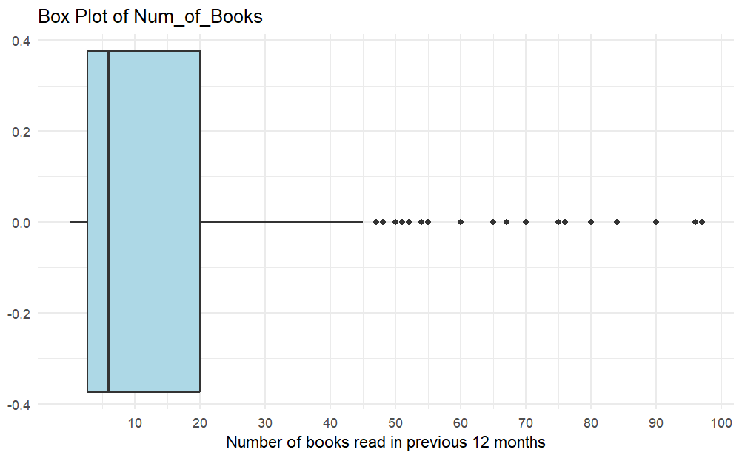
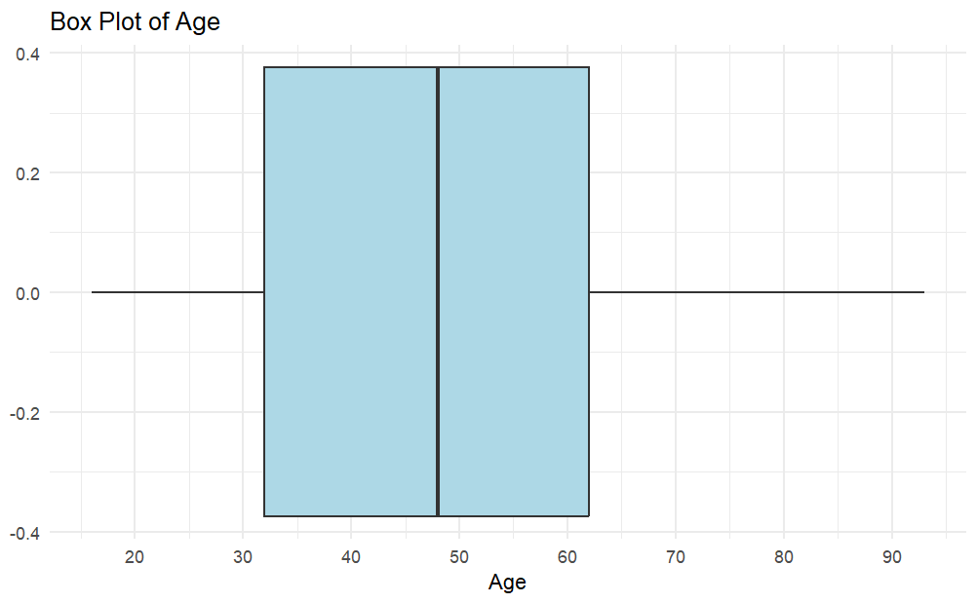
Box Plots – Num_of_Books & Age
Problem Identification | Data Preprocessing | Hypothesis Testing | Machine Learning Models | Interpreting Results
7

Slide 8
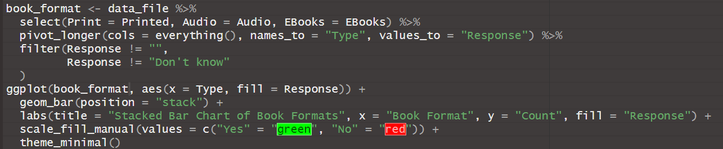
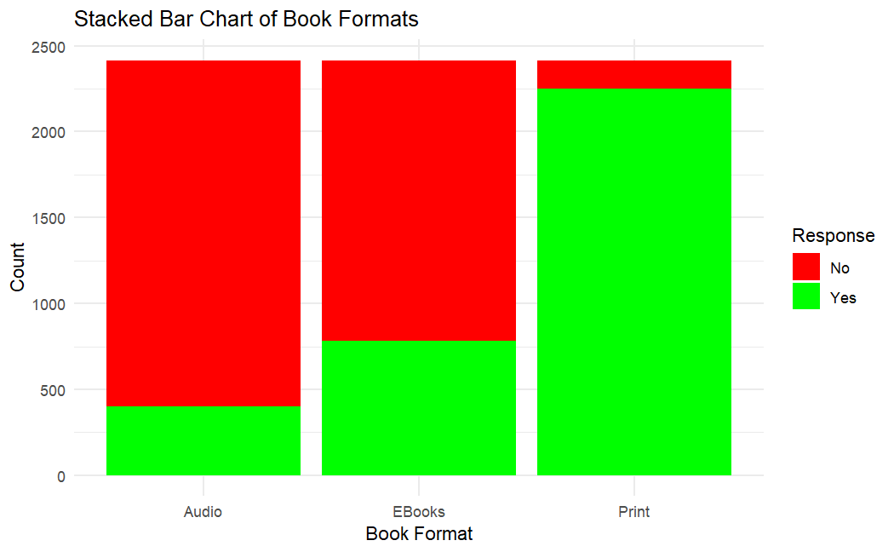
Stacked Bar Chat – Book Format
Problem Identification | Data Preprocessing | Hypothesis Testing | Machine Learning Models | Interpreting Results
8

Slide 9
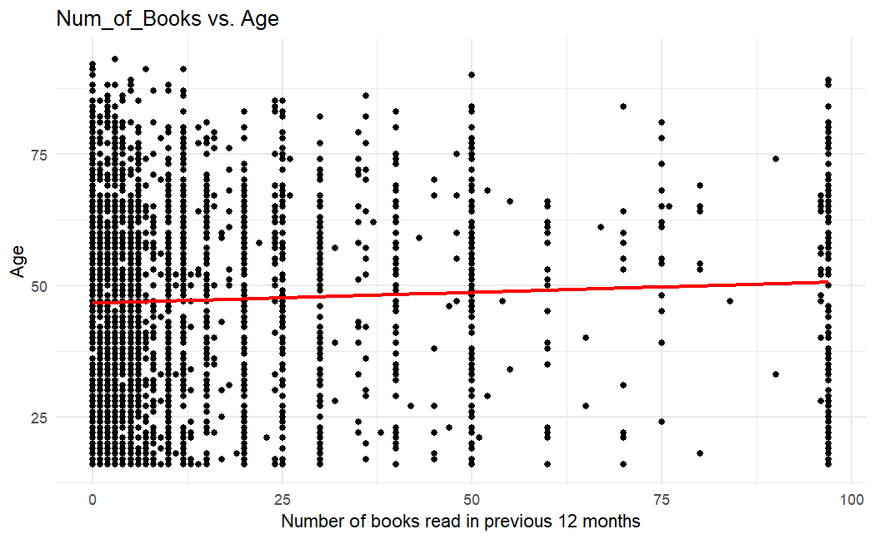
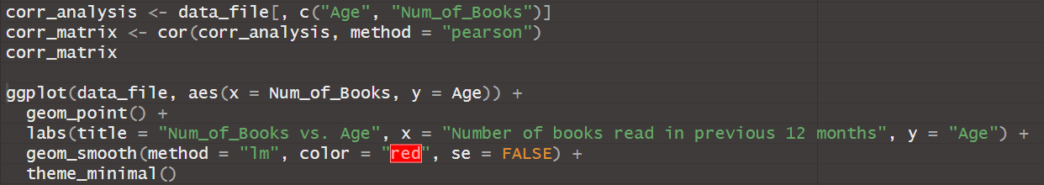
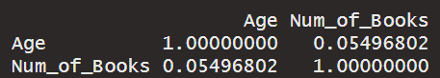
Correlation Analysis
Hypotheses
H₀: There is no correlation between Age and Num_of_Books
H_{a}: There is a correlation between Age and Num_of_Books
Results
Correlation = 0.0524209; little to no correlation
Fail to reject null hypothesis
Problem Identification | Data Preprocessing | Hypothesis Testing | Machine Learning Models | Interpreting Results
9

Slide 10
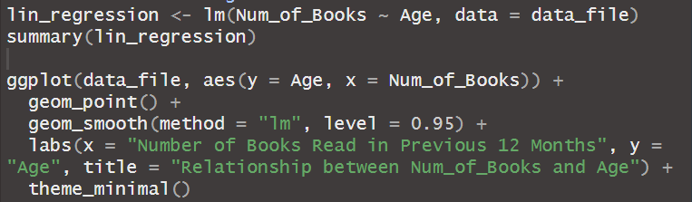
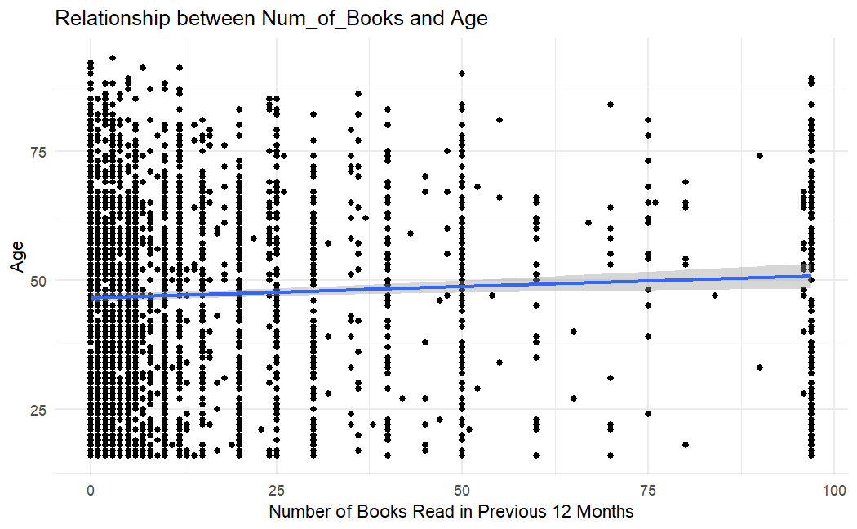
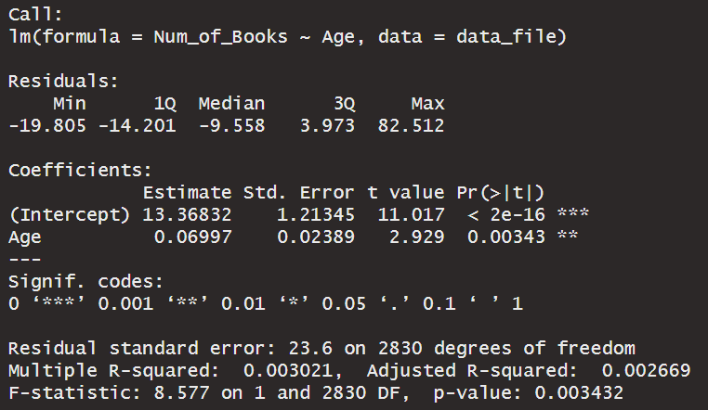
Simple Linear Regression
Objective: Analyze whether Age can predict Num_of_Books.
Findings:
Regression Equation: Num_of_Books = 13.37 + 0.07(Age)
R² = 0.003021; very weak relationship
p-value = 0.003432; statistically significant
Conclusion: Despite being statistically significant, the relationship between Age and Num_of_Books is very weak.
Problem Identification | Data Preprocessing | Hypothesis Testing | Machine Learning Models | Interpreting Results
10

Slide 11
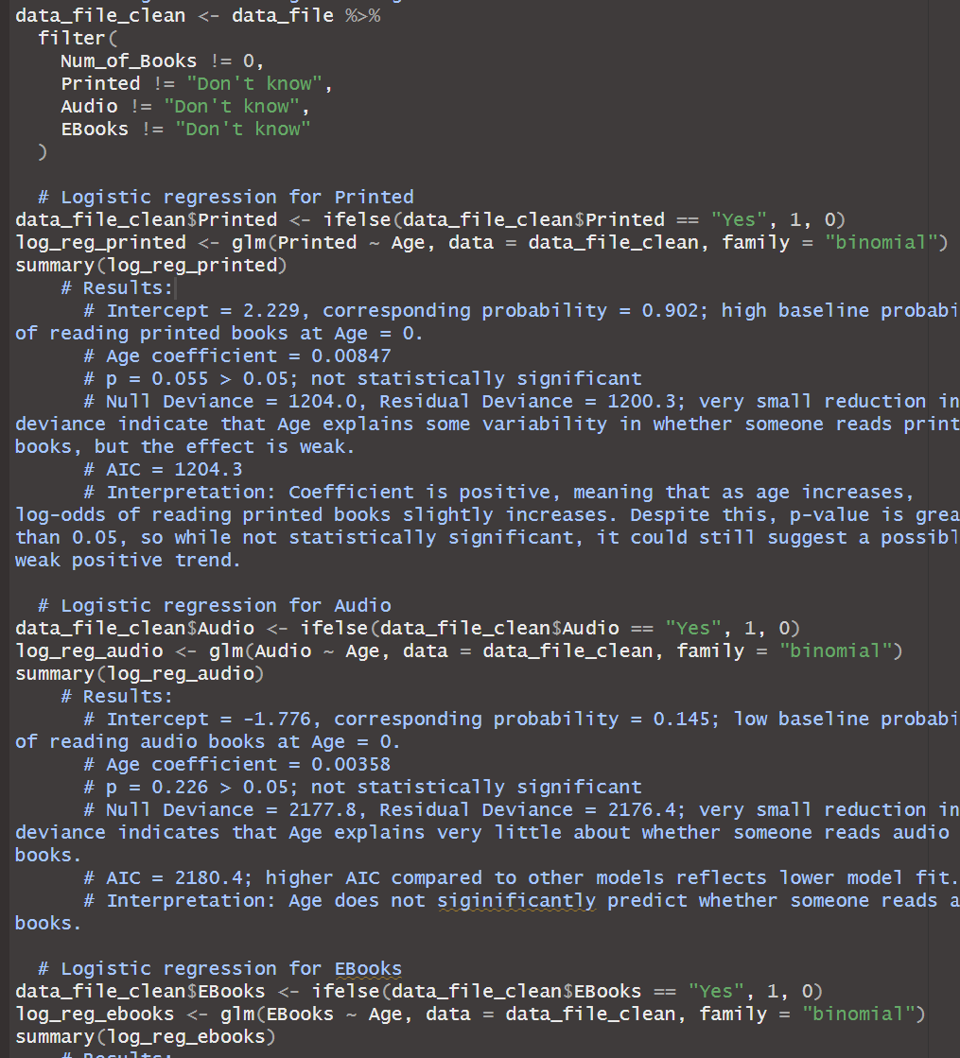
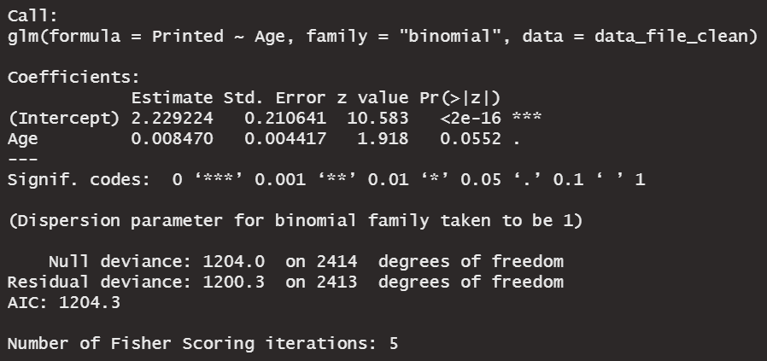
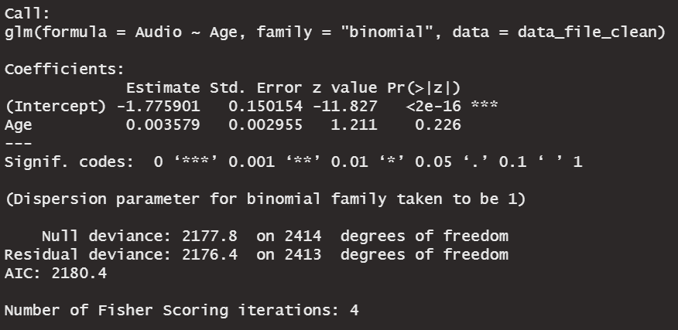
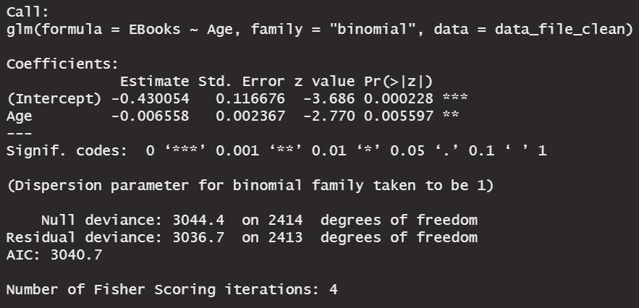
Binary Logistic Regressions
Objective: Analyze whether Age can predict Printed, Audio, and/or EBooks.
Cleaning data for book format variables
Logistic regression code
Output for Printed
Output for Audio
Output for EBooks
Problem Identification | Data Preprocessing | Hypothesis Testing | Machine Learning Models | Interpreting Results
11

Slide 12
Binary Logistic Regressions cont.
Findings and Conclusions
 | Printed | Audio | EBooks
Intercept | 2.229 (P = 0.902) High baseline probability of reading printed books at Age = 0 | -1.776 (P = 0.145) Low baseline probability of reading audio books at Age = 0 | -0.430 (P = 0.394) Baseline probability of ~39.4% of reading eBooks at Age = 0
Age Coefficient | 0.00847 (P = 0.055) Not significant | 0.00358 (P = 0.226) Not significant | -0.00656 (P = 0.0056) Statistically significant
Deviance | N = 1204.0 R = 1200.3 Very small reduction | N = 2177.8 R = 2176.4 Very small reduction | N = 3044.4 R = 3036.7 Very small reduction, but better than others
Interpretation | Age does not significantly predict whether someone reads printed books. | Age does not significantly predict whether someone reads audio books. | Older respondents are significantly less likely to read eBooks than younger ones.
Problem Identification | Data Preprocessing | Hypothesis Testing | Machine Learning Models | Interpreting Results
12

Slide 13
Interpreting Results
Hypothesis Test
Correlation Analysis: There is no correlation between Age and Num_of_Books, suggesting that age is not related to reading volume.
Machine Learning Models
Linear Regression
The relationship between Age and Num_of_Books is statistically significant, but extremely weak. Age is an insufficient predictor of reading frequency.
Logistic Regression
Younger reads are significantly more likely to purchase eBooks than older readers.
No significant relationship between printed books and age, suggesting there is likely broad appeal for this format.
No significant relationship between audio books and age, suggesting there is broad disinterest in this format.
Overall Conclusions
Age is not a strong determinant of reading habits but may play a role in more minor preferences.
Problem Identification | Data Preprocessing | Hypothesis Testing | Machine Learning Models | Interpreting Results
Problem Identification | Data Preprocessing | Hypothesis Testing | Machine Learning Models | Interpreting Results
13

Slide 14
Expectations & Recommendations
Expectations
Expected results to show that older people read more than younger people.
Expected printed books to book popular overall, eBooks to be popular for younger-middle aged respondents, and audio books to be popular only among younger readers.
Recommendations
Personalize marketing campaigns to specific demographics based on book format.
Test audio and/or eBook exclusive book releases, especially for books aimed toward older readers.
Implement Goodreads membership tier, partner with Audible and/or Kindle to increase digital book format usage.
Problem Identification | Data Preprocessing | Hypothesis Testing | Machine Learning Models | Interpreting Results
Problem Identification | Data Preprocessing | Hypothesis Testing | Machine Learning Models | Interpreting Results
14

Slide 15

Thank you! Questions?

